Slide 1



CULTURE SPOT 2
Around London

Slide 2
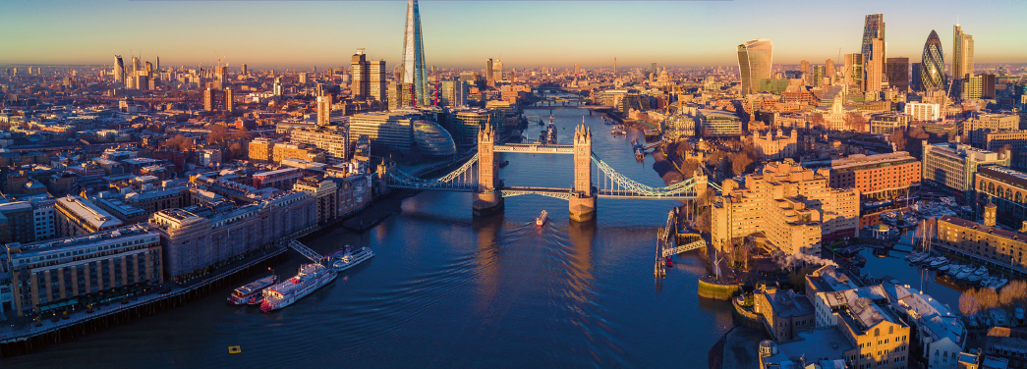
How much do you know about London?
Do you know any famous places in London?
Do you know any famous Londoners?

Slide 3
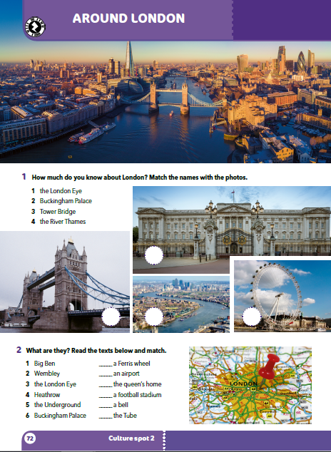
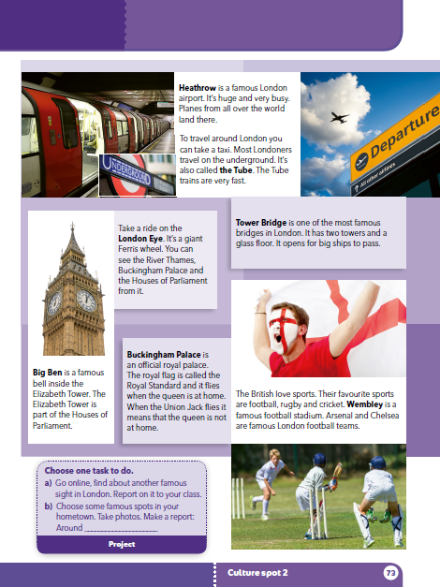

Slide 4
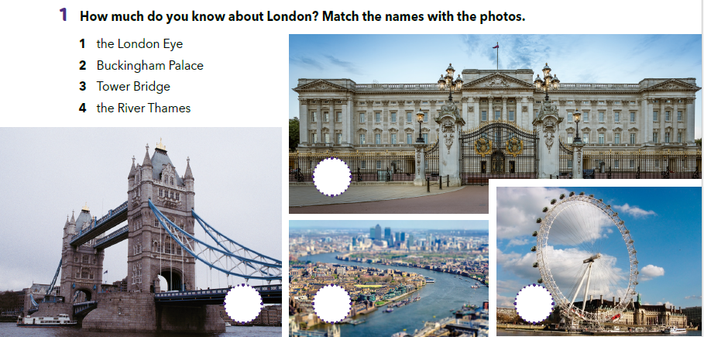
Match the names with the photos.
2
3
4
1

Slide 5
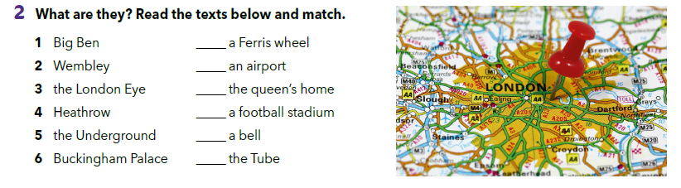
3
4
6
2
1
5
Read the texts on page 73 and check your answers.

Slide 6
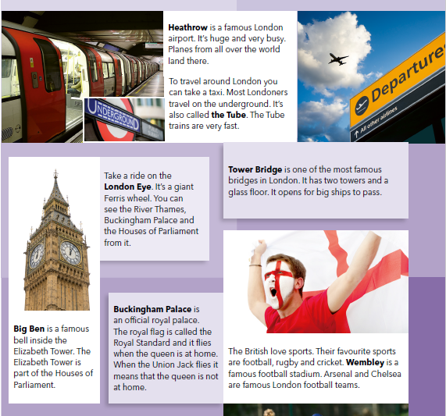
What do people use Heathrow for?
Why do Londoners use the Tube?
London Eye: What can you see from it?
How is the Tower Bridge different from other bridges?
What is Big Ben?
How do people know when the king or queen is at home?
What are Arsenal and Chelsea?
Do you know any footballers who played for Arsenal or Chelsea?

Slide 7
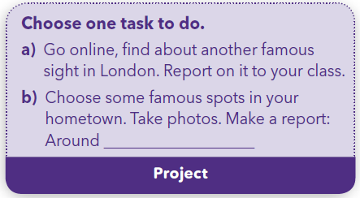

Slide 8
Click on the link and take the virtual tour around London.
https://360.visitlondon.com/#
London landmarks check https://wordwall.net/play/552/989/412

